Slide 1
Car Price Prediction
LINEAR REGRESSION MODEL

Slide 2
Problem statement
Reason for selection
Possible applications
About the model
Accuracy and Loss
Conclusion
Contents

Slide 3
Problem Statement:
The problem addressed in this case study is car price prediction. Given customer attributes such as age, annual salary, credit card debt, and net worth, the objective here is to predict the amount a customer is likely to spend on purchasing a car.

Slide 4
Reason for selection:
1. It is a model for performing tasks that involve regression like price prediction. 2. It identifies relationships between input features and the target variable that are non-linear. 3. It helps predict prices that may not have a simple linear correlation with customer attributes. 4.The model can learn from data patterns and generalize it to make accurate predictions.

Slide 5
Possible Applications of the Model:
Car Dealerships: Car dealerships can use this model to estimate how much a customer is likely to spend on a car, enabling them to offer tailored options and promotions.
Financial Institutions: Banks and credit institutions can use this information to assess a customer's creditworthiness and make loan decisions.
Marketing: Businesses can use the model to target potential car buyers with personalized advertising and promotions.
Customer Insights: The model can provide insights into customer behavior and preferences based on their financial profiles.

Slide 6
PREPROCESSING

Slide 7
Data Preprocessing: We imported the necessary libraries such as numpy, pandas, matplotlib, tensorflow and keras. The dataset was then loaded using pandas, and data exploration was performed, including identifying : 1. Country with Highest Number of Car Purchases 2. Bar Graph on Top 25 Countries with the Most Customers 3. Pie Chart on Customer Ages

Slide 8
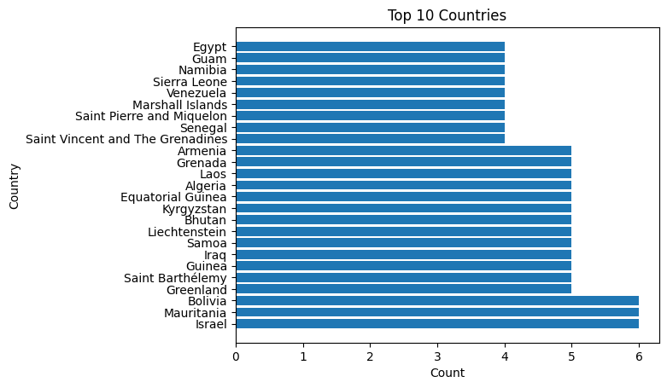

Slide 9
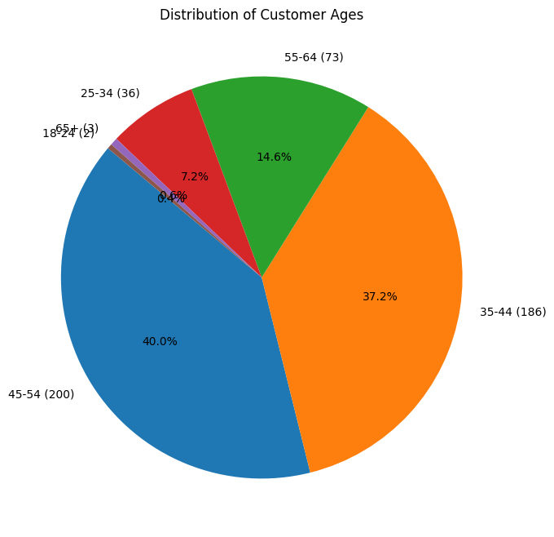

Slide 10
Data Selection: The unnecessary columns which did not contribute to the prediction were dropped, which included: 1. Customer name 2. Customer e-mail 3. Country 4. Gender
The 4 features (age, annual salary, credit card debt, net worth) were scaled using MinMaxScaler ( ) function. The dataset was split into training and testing sets using train_test_split.

Slide 11
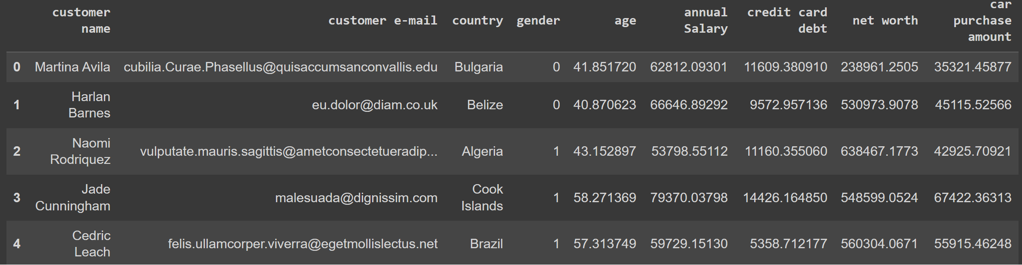
'df.head()' was used to print the first 5 rows of the Dataframe

Slide 12
ABOUT THE MODEL

Slide 13
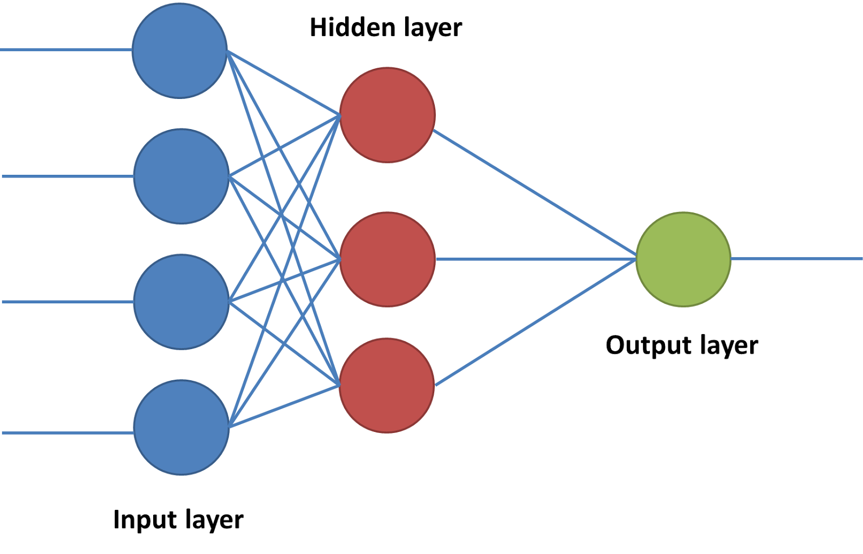
Model architecture: The ANN model consists of three layers: Layer 1 – 25 neurons (input layer) Layer 2 – 10 neurons ( hidden layer) Layer 3 – 1 neurons (output layer)

Slide 14
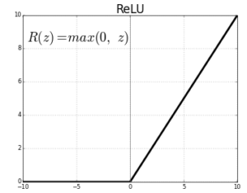
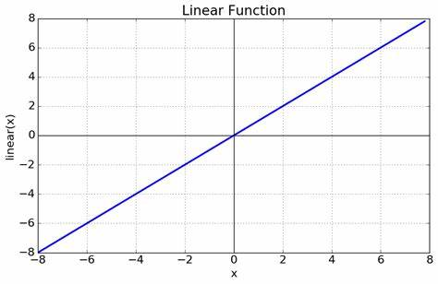
Activation functions used: 1. Relu Activation function 2. Linear Activation function

Slide 15
Model compilation: The following were used to compile the model: Optimizer : Adam optimizer Loss : Mean squared error Metrics: Mean absolute error Metrics include, Training loss, Training accuracy, Validation loss and Validation accuracy.

Slide 16
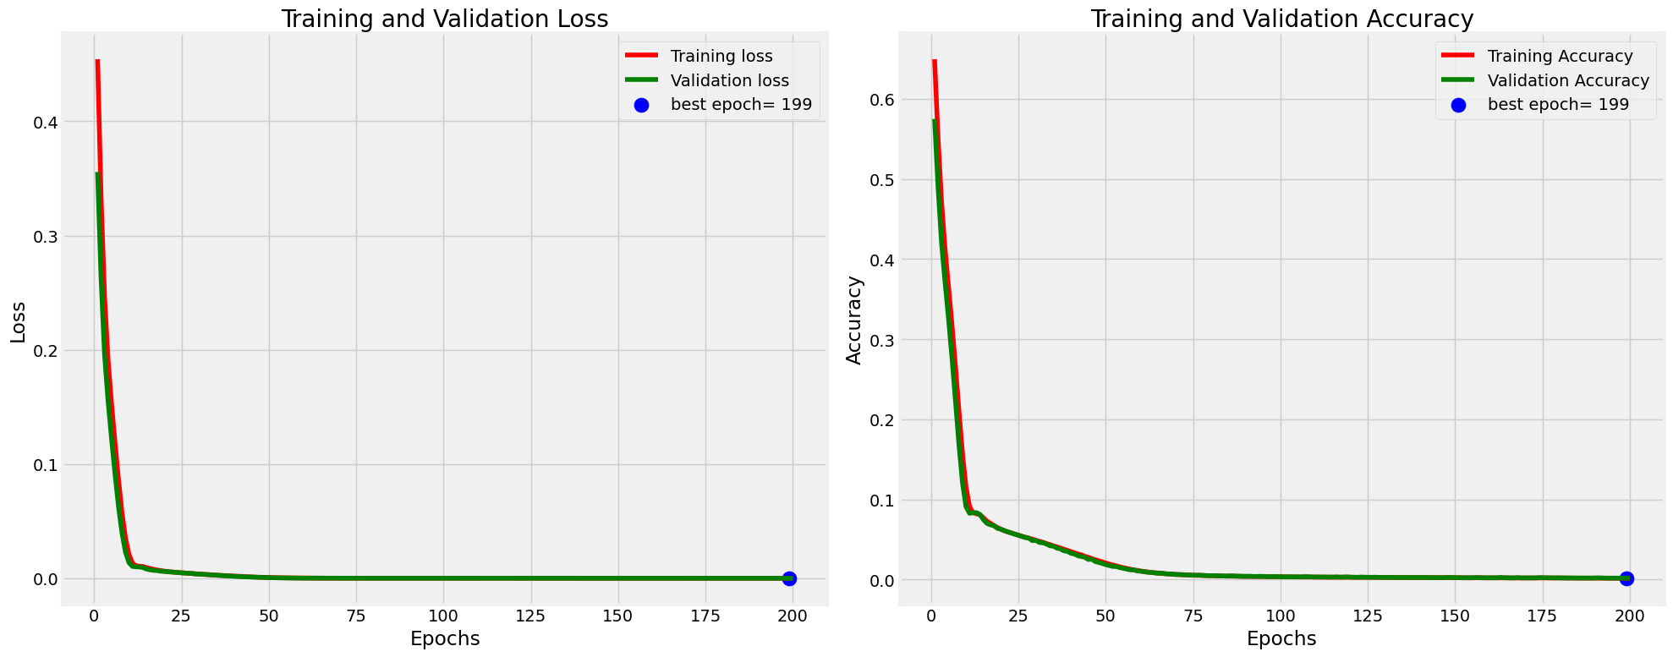
Using model history, Training loss, Training accuracy, Validation loss and Validation accuracy were plotted and it was observed that the best epoch is the 199th iteration.

Slide 17
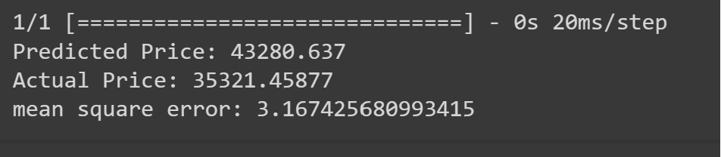
Car Price Prediction: We used the trained model to predict the car price for a sample customer and calculated the mean squared error.

Slide 18
The linear regression model was applied on the test data which was 25% of the total data and a remaining training data of 75%. The accuracy was calculated by using the R-squared (R2) score which is, R^2 = (r)^2 This represents how close the model is to the actual output.

Slide 19
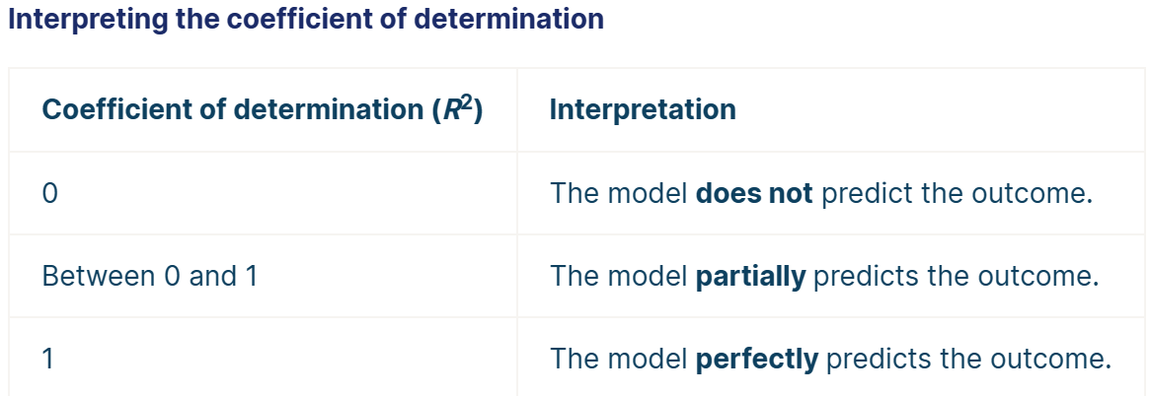
The model's R2 score was 0.9985301745950076, which is very close to 1 and this indicates a strong ability to predict car purchase amounts.

Slide 20
Case Study by: Krishna Varma Vetukuri Hu21csen0300138 Patham Sravya Hu21csen0300159

